Slide 1
Protein domains search pipeline
~3k datasets with
assembled contigs
Inputs:
the (assembled) contigs
protein domain models
✘ ~300k CDD, no PFAM, POGs, etc. to avoid later work in filtering overlapping hits
✓ ~2k “viral”-enriched set from Rodney

Slide 2
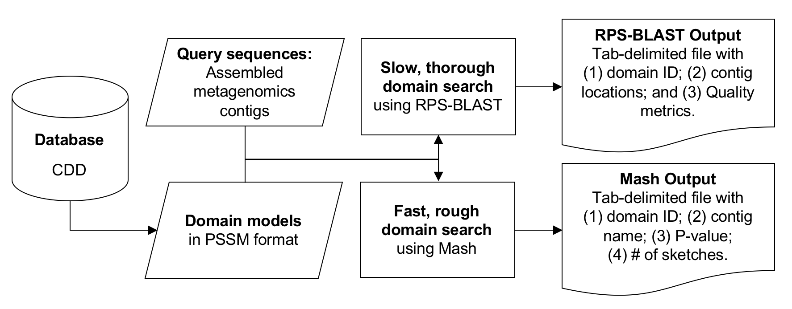
Domain search workflow

Slide 3
Protein domains search pipeline
~3k datasets with
assembled contigs
Inputs:
the (assembled) contigs
protein domain models
✘ ~300k CDD, no PFAM, POGs, etc. to avoid later work in filtering overlapping hits
✓ ~2k “viral”-enriched set from Rodney

Slide 4
Protein domains search pipeline
~3k datasets with
assembled contigs
~100k datasets with
non-assembled reads
Inputs:
the (assembled) contigs
protein domain models
✘ ~300k CDD, no PFAM, POGs, etc. to avoid later work in filtering overlapping hits
✓ ~2k “viral”-enriched set from Rodney
Inputs:
the (non-assembled) reads
protein domain models
but...how to connect?
k-mers – build our own method?
min-hash, if it would work?
?Dataset clustering?

Slide 5
Kmer-6
500
Common (very low …)
Rpstbln
mash

Slide 6
Kmer-6
rpstbln
Mash

